Slide 1
Boot Camp Final Project University of Toronto SCS - Data Analytics
Investor Financial Dashboard
Project Member:
Suman Raj

Slide 2
Dashboard Serves below things:
Features
Benefits
1
Interactive Dashboard
Allows investors to interactively analyze various stock points
2
Stock Prediction
Allows Investors to forecast the stock share prices.
Latest business news from tweeter and map
Allows user to know about the company in more detail.
3

Slide 3
Technology Used
Simple Interface
Interactive visualization
Facebook Prophet
Long Short-Term Memory
Power BI
SciKit Learn(ML model)
Programming Language
Database
Python 3
MySQL

Slide 4
Use Case: User must be able to do below things with the dashboard
Depict price charts of the various companies
Provide price prediction chart of Facebook Prophet ML Model
Provide price prediction chart of Long Short Term Memory ML Model
All data to exist on MySQL DB
Power BI slicer automation

Slide 5
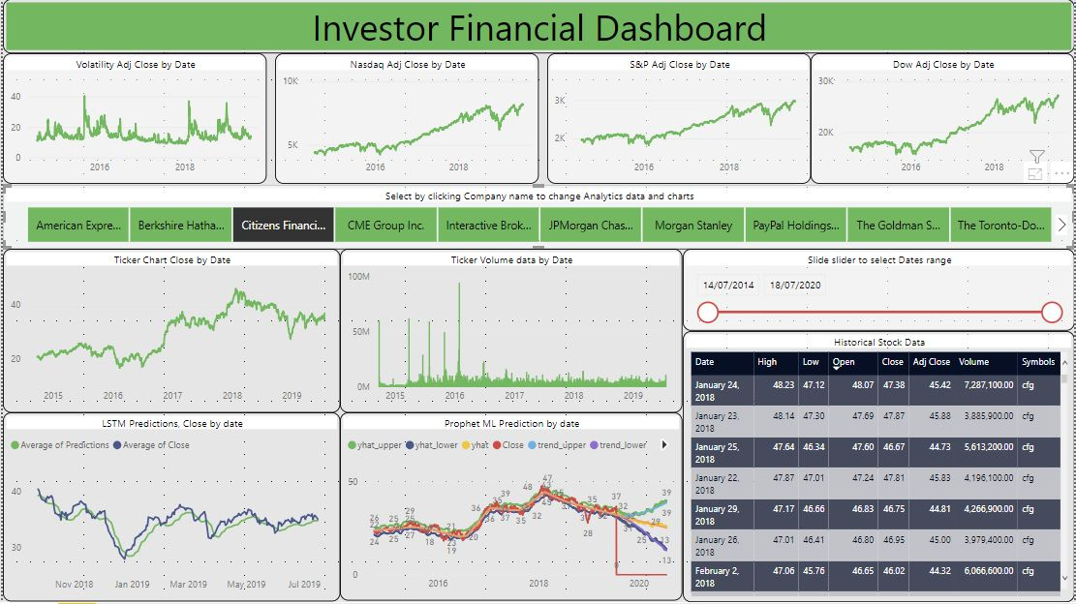
Use Case: continued…

Slide 6
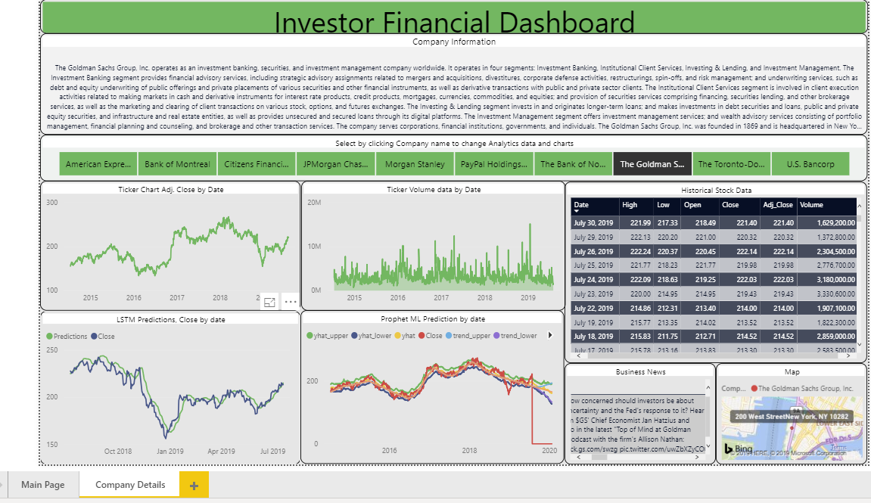

Use Case continued…

Slide 7

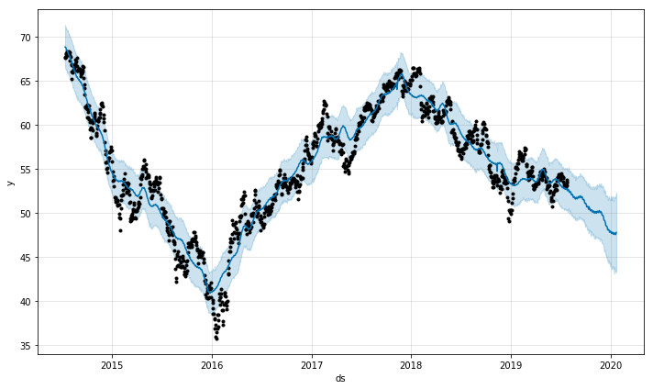
Fb prophet visualization for one of the company

Slide 8
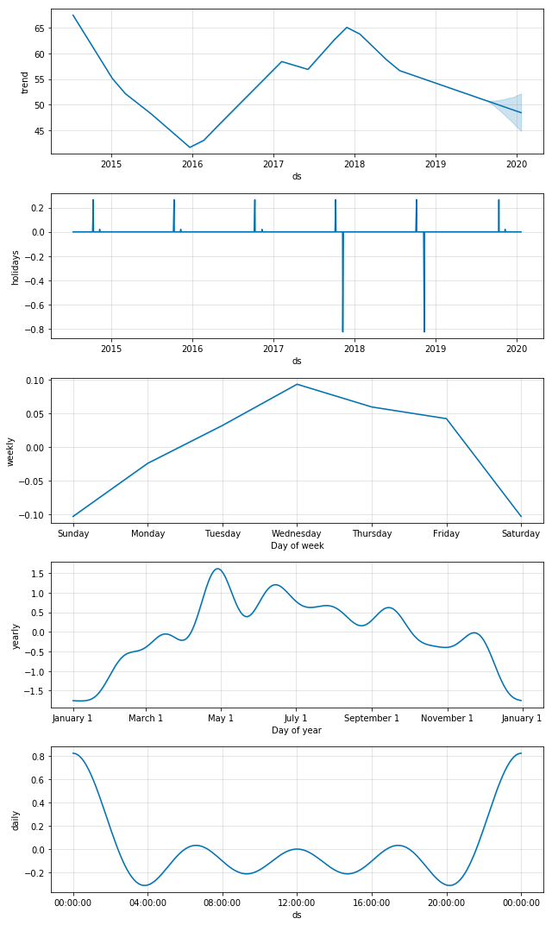
Let’s see the insights

Slide 9
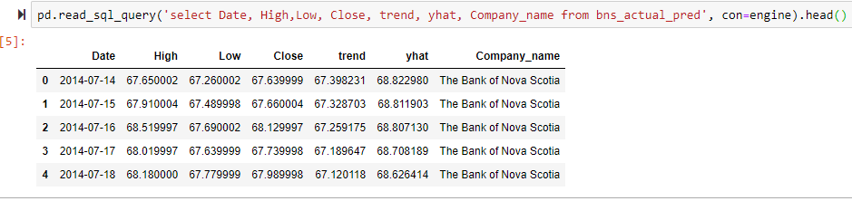
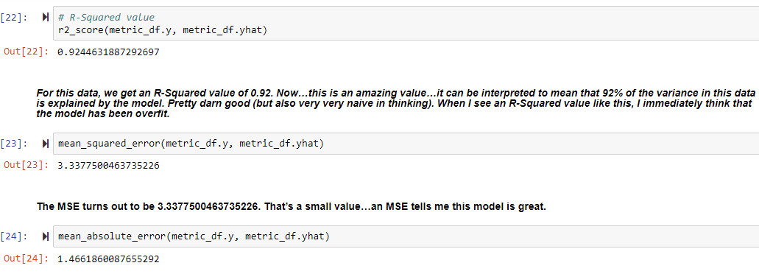
Table

Slide 10
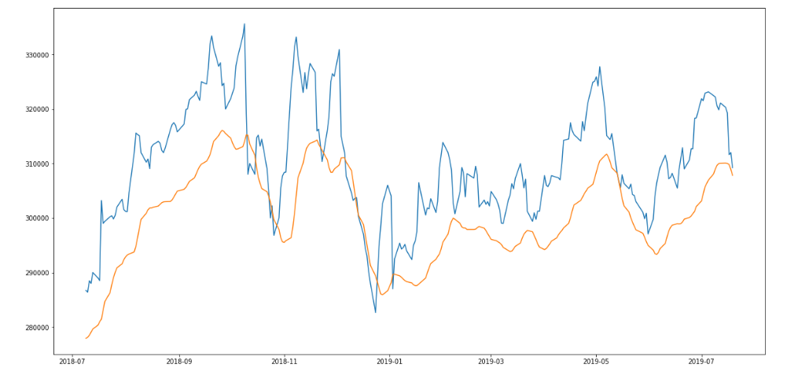
Long Short Term Memory model visualization for one of the company

Slide 11
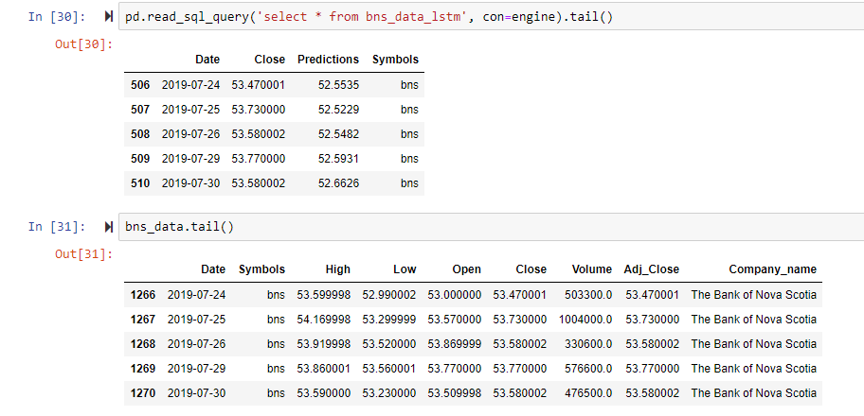
Table

Slide 12
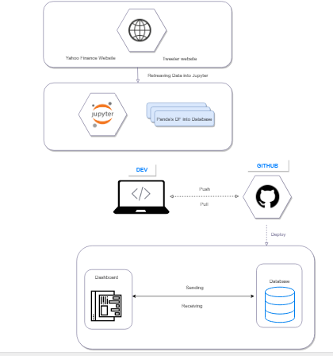
Architecture

Slide 13
Challenges
Challenges faced:
Machine learning modules incompatibility
Machine learning model accuracy
Machine learning data splitting for test, train and prediction
Power BI customization
Power BI table relationship management

Slide 14
Thanks..

